Slide 1
CLASS in O.O.P
In object-oriented programming languages like C++, the data and functions (procedures to manipulate the data) are bundled together as a self-contained unit called an object. A class is an extended concept similar to that of structure in C programming language; this class describes the data properties alone. In C++ programming language, a class describes both the properties (data) and behaviors (functions) of objects. Classes are not objects, but they are used to instantiate objects.
What is a class?
A class is an abstract data type similar to 'C structure'.
The Class representation of objects and the sets of operations that can be applied to such objects.
The class consists of Data members and methods.
The primary purpose of a class is to hold data/information. This is achieved with attributes which are also known as data members.
The member functions determine the behavior of the class i.e. provide a definition for supporting various operations on data held in form of an object.

Slide 2
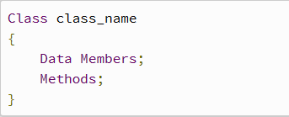
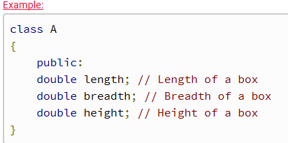
Definition of Class:
Private, Protected, Public is called visibility labels.
The members that are declared private can be accessed only from within the class.
Public members can be accessed from outside the class also.
In C++, data can be hidden by making it private.

Slide 3
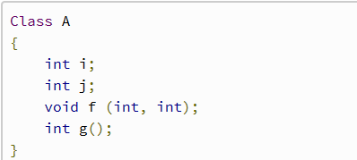
Class Members
Data and functions are members.
Data Members and methods must be declared within the class definition.
f and g are a member function of class A. And i and j are data members of class A.
They determine properties and behavior of the objects of class A.
The public data members of objects of a class can be accessed using the direct member access operator (.).

Slide 4
#include<iostream>
using namespace std;
class Box
{
public:
double length; // Length of a box
double breadth; // Breadth of a box
double height; // Height of a box
};
int main( )
{
Box Box1; // Declare Box1 of type Box
Box Box2; // Declare Box2 of type Box
double volume = 0.0; // Store the volume of a box here
// box 1 specification
Box1.height = 4.0;
Box1.length = 6.0;
Box1.breadth = 3.0;
// box 2 specification
Box2.height = 10.0;
Box2.length = 12.0;
Box2.breadth = 12.0;
// volume of box 1
volume = Box1.height * Box1.length * Box1.breadth;
cout <<"Volume of Box1 : " << volume <<endl;
// volume of box 2
volume = Box2.height * Box2.length * Box2.breadth;
cout <<"Volume of Box2 : " <<volume <<endl;
return 0;
}

Slide 5
Access Modifiers in C++
Access modifiers are used to implement an important feature of Object Oriented Programming known as Data Hiding.
Consider a real-life example: Consider Indian secret informatic system having 10 senior members, have some top secret regarding national security. So we can think that 10 people as class data members or member functions who can directly access secret information from each other but anyone can’t access this information other than these 10 members i.e. outside people can’t access information directly without having any privileges. This is what data hiding is.
Access modifiers or Access Specifiers in a class are used to set the accessibility of the class members. That is, it sets some restrictions on the class members not to get directly accessed by the outside functions.
There are 3 types of access modifiers available in C++:
Public Private Protected
Note: If we do not specify any access modifiers for the members inside the class then by default the access modifier for the members will be Private.

Slide 6
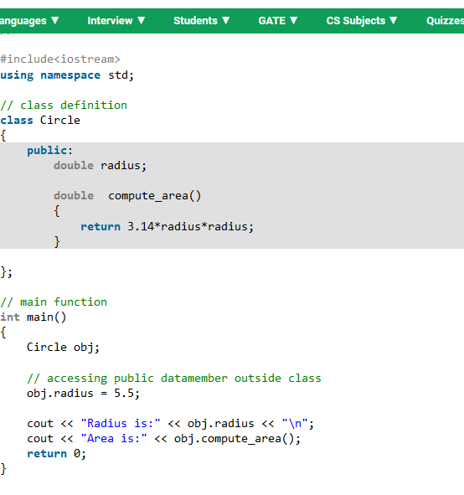
Let us now look at each one these access modifiers in details:
Public: All the class members declared under public will be available to everyone. The data members and member functions declared public can be accessed by other classes too. The public members of a class can be accessed from anywhere in the program using the direct member access operator (.) with the object of that class.

Slide 7
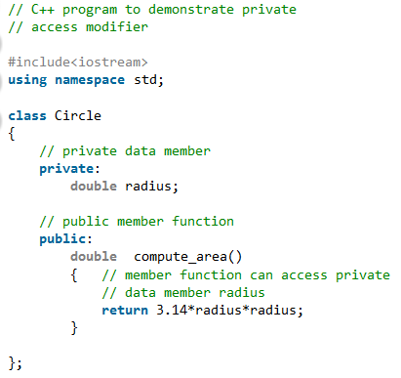
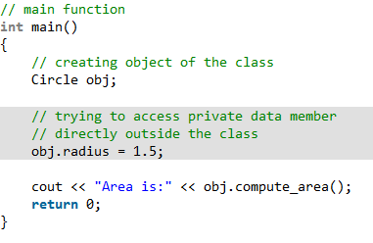
Private: The class members declared as private can be accessed only by the functions inside the class. They are not allowed to be accessed directly by any object or function outside the class. Only the member functions or the friend functions are allowed to access the private data members of a class.

Slide 8
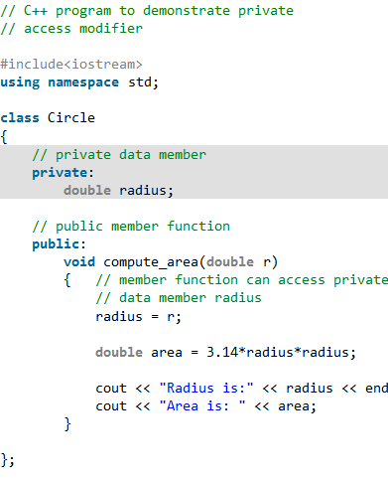
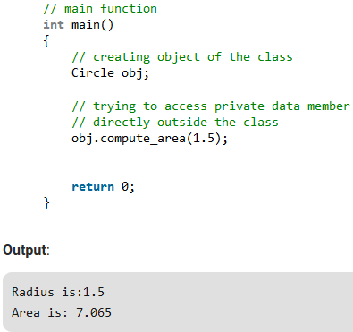
The output of above program will be a compile time error because we are not allowed to access the private data members of a class directly outside the class. Output:
In function 'int main()': 11:16: error: 'double Circle::radius' is private double radius; ^ 31:9: error: within this context obj.radius = 1.5;
^
However, we can access the private data members of a class indirectly using the public member functions of the class. Below program explains how to do this:

Slide 9
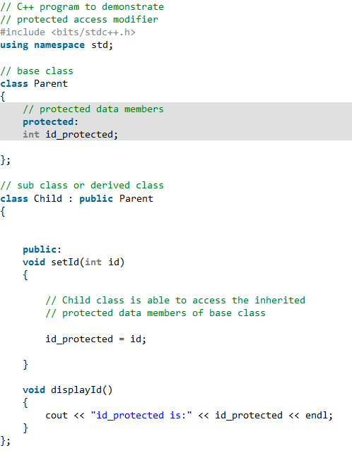
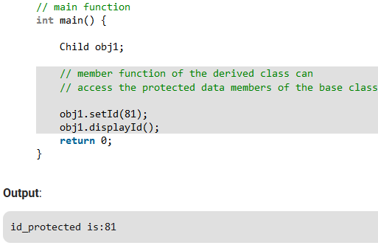
Protected: Protected access modifier is similar to that of private access modifiers, the difference is that the class member declared as Protected are inaccessible outside the class but they can be accessed by any subclass(derived class) of that class.

Slide 10
Employee Details using class & member function
calculator program using class

Slide 11
#include<iostream>
using namespace std;
class employee
{
int emp_no;
char emp_name[20];
float emp_sal;
public:
void get();
void dis();
};
void employee::get()
{
cout<<"Enter employee number:";
cin>>emp_no;
cout<<"Enter employee name:";
cin>>emp_name;
cout<<"Enter salary:";
cin>>emp_sal;
}
void employee::dis()
{
cout<<"\n\tEmployee Details";
cout<<"\n\t Number : "<<emp_no;
cout<<"\n\t Name : "<<emp_name;
cout<<"\n\t Salary : "<<emp_sal;
}
int main()
{
//clrscr();
employee e1,e2,e3;
e1.get();
e2.get();
e3.get();
e1.dis();
e2.dis();
e3.dis();
//getch();
return 0;
}

Slide 12
Object Oriented Programming
Encapsulation

Slide 13
Objectives:
◆ What is Encapsulation?
◆ Why Encapsulation?
◆ Syntax
◆ Example
◆ Advantages and achievements

Slide 14
What is Encapsulation?
◆ "A language mechanism for restricting access to some of the object's components"
◆ Encapsulation is the process of combining data and functions into a single unit called class.
◆ Data is only accessible through the functions present
inside the class.

Slide 15
What is Encapsulation?
◆ Hiding the implementation details and providing restrictive access leads to the concept of abstract data type.
◆ Data encapsulation led to the important concept of data hiding.

Slide 16
Why Encapsulation?
◆ "It gives us secure and consistence results".
Means that it gives the user access to a limited data and keeps our valuable data which can change our program or increase the possibilities of mistakes hidden from the user.
◆ We can understand this more by this example:
Assume we made a Rectangle class that contained four variables –
length, width, area, and perimeter.

Slide 17
Why Encapsulation?
◆ Please note that area and perimeter are derived from length and width, so that changing length would change both area and perimeter. If you did not use proper information hiding (encapsulation), then another program utilizing that Rectangle class could alter the length without altering the area, and you would have an inconsistent Rectangle..

Slide 18
Why Encapsulation?
◆ Using encapsulation, we can create a function that, if a program wanted to change the length of the rectangle, that the object would appropriately update its area and perimeter without being inconsistent.
◆ The ideal is to keep as many of the details of each class
hidden from all other classes as possible.

Slide 19
Syntax:
◆ The syntax of encapsulation is very easy, for encapsulation we have to declare a class and then we have to mark or tell in our program which data we want to show and which we want to hide.
class Box
{
public:
double getVolume(void)

Slide 20
Syntax:
{
return length * breadth * height;
}
private:
double length; double breadth; double height;
// Length of a box
// Breadth of a box
// Height of a box
};

Slide 21
Example:
◆ We can understand it more by a C++ program
#include <iostream>
#include<stdlib.h>
using namespace std;
class Adder{ public: Adder(int i = 0)

Slide 22
Example:
{
total = i;
}
// interface to outside world
void addNum(int number)
{
total += number;
}
int getTotal()

Slide 23
Example:
{
return total;
};
private: // This keeps our data hidden from the world int total;
};
int main( )
{
Adder a;

Slide 24
Example:
a.addNum(10);
a.addNum(20);
a.addNum(30);
cout << "Total " << a.getTotal() <<endl;
return 0;
}

Slide 25
Example:
◆ When the above code is compiled and executed, it produces the following result :
Result is 60.

Slide 26
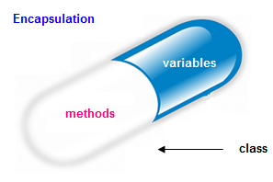
The common example of encapsulation is Capsule. In capsule all medicine are encapsulated inside capsule.

Slide 27
Advantages and Achievements
◆ Makes Maintenance of Application Easier.
◆ Improves the Understandability of the Application
◆ Enhanced Security

